Slide 1

Find, Grow, Keep: A Crash Course in Applied People Analytics
APA Convention | August 10, 2018
David A. Morgan
Global Director of Workforce Analytics

Slide 2
agenda
Listening Tour
Projects
Part I – Find, Grow, Keep Framework
Part II – Skills-building Session
What is:
I/O Psychology?
People Analytics?
Prevailing Areas of People Analytics
Find (e.g., recruiting)
Grow (e.g., training)
Keep (e.g., compensating)
Tools
R, Python, etc.
Data Science Tutorial
Employee Engagement

Slide 3
About the presenter
Current: Workforce Analytics, Micron Technology Inc.
Former: People Analytics, Facebook Inc.
Background: I/O Psychology; Quantitative Methods

Slide 4


About the presenter

Slide 5
Learning objects
Awareness of strategies for finding, developing, and retaining top talent in the workplace
Ability to recognize suitable tools for conducting applied people analytics
Understanding the purposes of various statistical and machine learning methods

Slide 6
Part I Introduction to People Analytics

Slide 7



What is i/o psychology?

Slide 8
What is Industrial/organizational psychology?
A branch of psychology that applies the principles of psychology to the workplace.
Aamodt, M.G. (2004). Applied Industrial/Organizational Psychology (4th Ed.). Belmont, CA: Thomson Wadsworth.
The scientific study of human behavior in organizations and the work place. The specialty focuses on deriving principles of individual, group and organizational behavior and applying this knowledge to the solution of problems at work.
Industrial and Organizational Psychology. (2018, August 1). Retrieved from http://www.apa.org/ed/graduate/specialize/industrial.aspx

Slide 9

What is Industrial/organizational psychology?
Organizational Psychology
Work Psychology
Occupational Psychology
Organizational Psychologist
HR Consultant
People Scientist/Researcher

Slide 10
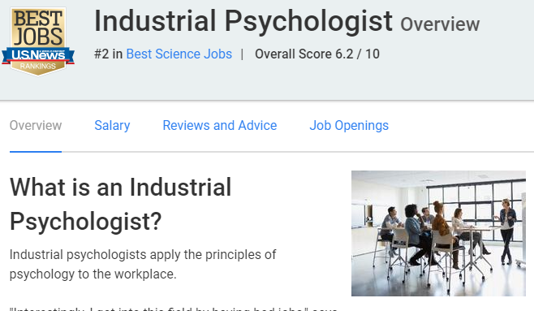
Fun fact
Industrial Psychologist Overview. (2018). U.S. News & World Report. Retrieved from https://money.usnews.com/careers/best-jobs/industrial-psychologist

Slide 11
What is People analytics?

Slide 12
What is people analytics?
A multidisciplinary field typically housed within the people (human resources) function of organizations, which leverages behavioral, social, and data science best practices, and focuses on attracting, developing and retaining essential talent.
Morgan, D.A. (2018). A Crash Course in Applied People Analytics. American Psychological Association Annual Convention, San Francisco, CA.

Slide 13

Popularization of “People analytics”
Bock, L. (2018). Work rules! Insights from inside Google that will transform how you live and lead. Twelve: New York, NY.

Slide 14
What is people analytics?
People Analytics
Workforce Analytics
HR Analytics
Talent Analytics
People Insights
Human Capital Analytics
"The HR Excel Team"
Productivity Insights
HR Metrics & Analytics
Strategic Workforce Planning & Analytics
HR Business Intelligence
HR Data Science
People Science
Psychometrics & People Research
People Intelligence
Employee Intelligence
Talent Insights
Employee Insights

Slide 15

Moneyball?
Not quite…

Slide 16
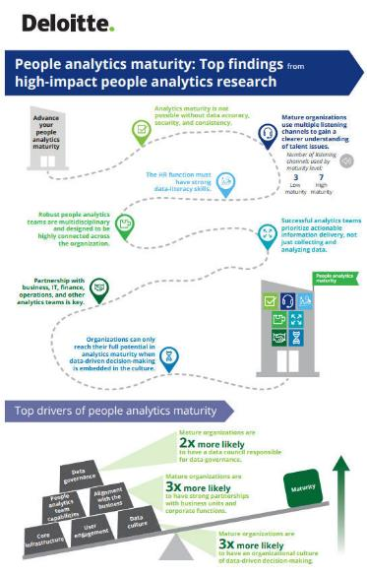

Slide 17
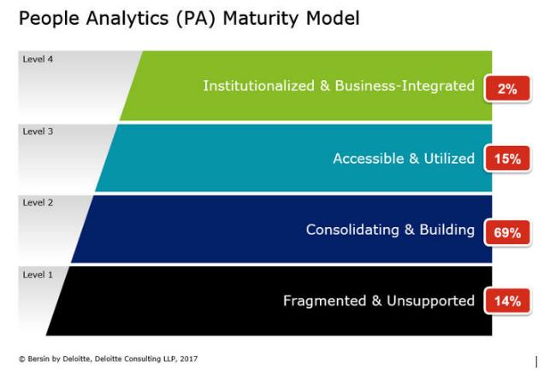

Slide 18
Find grow keep

Slide 19

Find: Recruiting and hiring
Identifying talent
Evaluating the recruiting and hiring funnel
Designing strategies to capture top talent

Slide 20
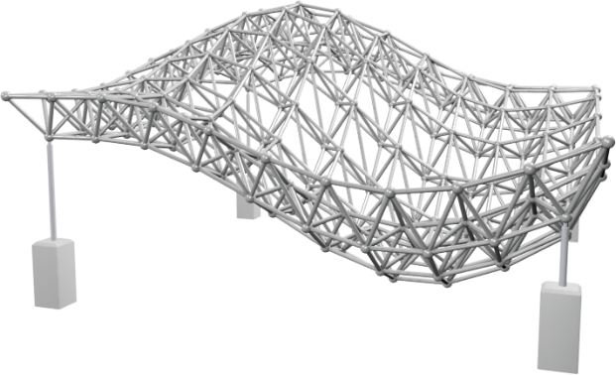
Find: Recruiting and hiring
A classic example: Structured interviewing
McDaniel, M.A., Whetzel, D.L., Schmidt, F.L., & Maurer, S.D. (1994). The validity of employment interviews: A comprehensive review and meta-analysis. Journal of Applied Psychology, 79, 599-616.

Slide 21
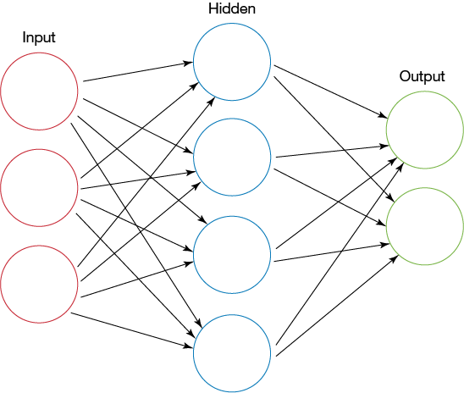
Find: Recruiting and hiring
A modern example: Ranking and placing candidates using AI

Slide 22
Find grow keep

Slide 23

Grow: learning, leadership, performance
Learning & development
Building great leaders
Flagging high potentials (HiPos)
Identifying key influencers and mentors
Implementing effective performance management

Slide 24

Find: learning, leadership, performance
A classic example: L&D program evaluation
Observational or quasi-experimental
Soloman four-groups design is the most rigorous
Matching techniques (e.g., Propensity Score Matching, or PSM)
 | Pretest | Training | Posttest
Group 1 | -- | ✓ | ✓
Group 2 | ✓ | ✓ | ✓
Group 3 | ✓ | -- | ✓
Group 4 | -- | -- | ✓

Slide 25
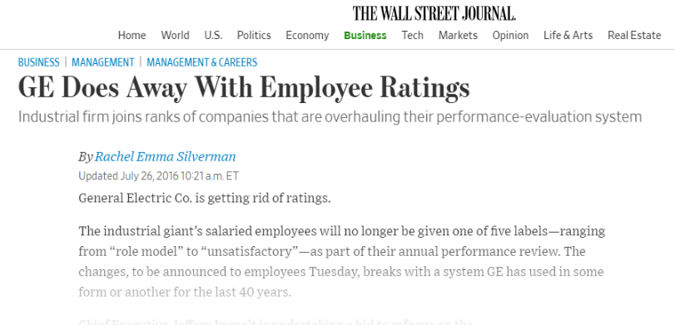
Find: learning, leadership, performance
Another classic example: Job performance evaluation
Silverman, R.E. (2016, July 26). GE Does Away with Employee Ratings. The Wall Street Journal. Retrieved
from https://www.wsj.com/articles/ge-does-away-with-employee-ratings-1469541602

Slide 26

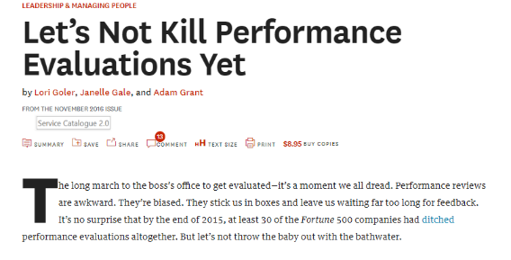
Find: learning, leadership, performance
Another classic example: Job performance evaluation
Goler, L., Gale, J., & Grant, A. (2016, November). GE Does Away with Employee Ratings. Harvard Business Review. Retrieved from https://hbr.org/2016/11/lets-not-kill-performance-evaluations-yet

Slide 27

Find: learning, leadership, performance
Multisource (360°) job performance feedback
When implemented properly, 360° feedback is an extremely useful tool
Quality 360° feedback requires the following:
A clearly defined purpose and process-oriented expectations
A focus on observable, important behaviors
An adequate number of trained feedback providers from multiple perspective groups
Quantitative and qualitative data collection
Accountability by all participants to follow-up on feedback
Follow-through on development
Outcomes associated with sustainable individual, team, or organizational changes
Bracken, D.W., Rose, D.S., Church, A.H. (2016). The evolution and devolution of 360° feedback. Industrial and Organizational Psychology, 9, 761-794. doi: https://doi.org/10.1017/iop.2016.93

Slide 28
Find grow keep

Slide 29

keep: Retaining top talent
Diversity & inclusion
Total rewards
Benefits programs
Employee engagement
Employee turnover

Slide 30

keep: Diversity & Inclusion
A classic example: Gender pay equity
Micron Technology, Inc.. (2018, June). Retrieved from https:https://www.linkedin.com/feed/update/urn:li:activity:6412891598689968128

Slide 31






keep: Diversity & Inclusion
A classic example: Gender pay equity
99.7¢ to the dollar
$1.000 to the dollar
100%
Spent $8.7M
“same as men”
80% of workforce
Apple, Inc.. (2018). https://www.apple.com/diversity/
Amazon.com, Inc.. (2018). https://www.amazon.jobs/landing_pages/diversity-and-inclusion
Adobe, Inc.. (2018). https://www.adobe.com/diversity.html
Intel, Inc.. (2018). https://blogs.intel.com/csr/2017/02/annual-report-2016/
Microsoft, Inc.. (2018). Retrieved from https://www.microsoft.com/en-us/diversity/inside-microsoft/default.aspx#epgDivFocusArea
Salesforce.com, Inc.. (2018). Retrieved from https://www.salesforce.com/company/equality/equal-pay/

Slide 32



keep: Turnover
A modern example: Predictive attrition modeling
Low employee engagement
Poor job performance
High tenure
Nature of the work/environment
Bad manager
Low team effectiveness
Acquired skills
Shocks to the system
Manager changes
Team attrition
Leaves of absence
Commute time/distance
Advancement
Compensation
Relocation
Experience
Referrals
VC funding

Slide 33
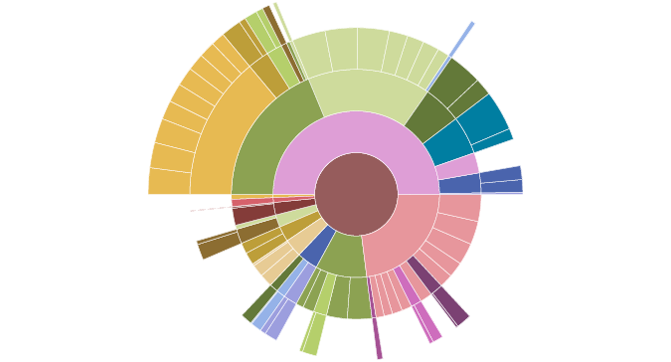
keep: Turnover
A modern example: Predictive attrition modeling
Intervention considerations…
Individual vs. Aggregate

Slide 34
What’s next for people analytics

Slide 35

Machine learning and AI
Opportunity for more deep learning applications
in HR…
Sourcing and recruiting
Text mining
Inference/understanding…eventually?
Small n…someday?

Slide 36
questions

Slide 37
Part II people analytics/data science tutorial

Slide 38


Data is the new currency
In an increasingly complex and connected world, the ability of an organization to collect, manage and analyze data effectively separates the winners from the runners-up.
Why Data is the New Business Currency. (2017). Retrieved from http://www.cioinsight.com/it-strategy/big-data/why-data-is-the-new-business-currency.htm

Slide 39
Tools

Slide 40






popular people analytics tools
MATLAB
®

Slide 41
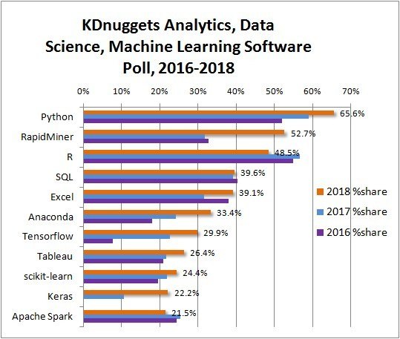
popular people analytics tools
Piatetsky, G. (2018, May 23). Python eats away at R: Top software for analytics, data science, machine learning in 2018 – Trends and analysis.
Retrieved from https://www.linkedin.com/pulse/python-eats-away-r-top-software-analytics-data-2018-gregory/

Slide 42
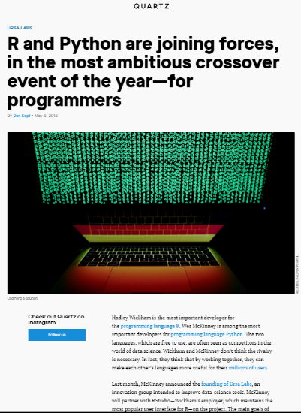
popular people analytics tools
Kopf, D. (2018, May 6). R and Python are joining forces, in the most ambitious crossover event of the year – for programmers. Retrieved from https://qz.com/1270139/r-and-python-are-joining-forces-in-the-most-ambitious-crossover-event-of-the-year-for-programmers/

Slide 43

What is ?
“An integrated suite of software facilities for data
manipulation, calculation and graphical display”
R Includes:
An effective data handling and storage facility
A suite of operators for calculations on arrays and matrices
A large, coherent, integrated collection of tools for data analysis
Graphical facilities for data analysis and display
A well developed, simple and effective programming language

Slide 44
How do it get ?
The Comprehensive R Archive Network (CRAN)
CRAN is a network of web servers around the world
Stores identical, up-to-date, versions of code and documentation for R
R can be extended easily via packages
Anyone can develop and share R packages on CRAN
As of 8/1/2018 CRAN featured 12,888 available packages!
https://cran.r-project.org/

Slide 45

Common people analytics tools
https://www.rstudio.com/

Slide 46
tutorial

Slide 47
Using
Extensive online help system:
> help.start() …opens your browser to R help
> help(mean) or > ?mean …help for specific functions
> help.search(“regression”) or > ??regression …help with concepts
> find(“t.test”) …what package to search in
> apropos(“glm”) …names all objects that (partially) match

Slide 48
Using
Some native R functions have demos:
> demo(Hershey) …fonts and characters
> demo(plotmath) …equation editor
> demo(persp) …density plots
> demo(graphics) …plots and charts

Slide 49
Using
R Console
You can type commands directly into the console
Expressions
The R interpreter will evaluate the expressions and respond with a result (or an error)
You will see the default command prompt >
For example > 17+3
If you enter an incomplete command, R will prompt you with a +
For example, > 1 * 2 * 3 * 4 * 5 *
+ 6 * 7 * 8 * 9 * 10
Scroll up or down to see history, or type history()

Slide 50
Using
R as a Calculator
> print(“Hello world!”) or “Hello world!” (case sensitive)
[1] “Hello world!”
> 1 + pi
[1] 4.141593
> 234/87754
[1] 0.002666545

Slide 51
Using
R as a Calculator
> (1 + 0.05)^8
[1] 1.477455
> 23.76*log(8)/(23 + tan(9))
[1] 2.191246
The “[1]” means that the index of the first item displayed in the row is 1

Slide 52
Using
Vectors
In R, any number that is entered in the console is interpreted as a vector (an ordered collection of numbers)
You can create longer vectors using the c(…) function
> c(0, 1, 1, 2, 7, 9)
[1] 0 1 1 2 7 9

Slide 53
Using
Vectors
Use the sequence operator
> 1:30
[1] 1 2 3 4 5 6 7 8 9 10 11 12 13 14 15 16 17 18 19 20 21 22 23 24 25 26 27 28 29 30
Perform an operation on two vectors
> c(1, 2, 3) + c(11, 13, 15)
[1] 12 15 18
Enter expressions using characters
> “APA is awesome!
[1] “APA is awesome!”

Slide 54
Using
Functions
In R, functions performance all of the work
Most functions take the following general form: f(argument1, argument2, …)
> exp(1)
[1] 2.718282
Some functions are in the form of operators
> 3==4
[1] FALSE

Slide 55
Using
Functions
You can define your own functions, and “call” them in R
> my.function <- function(x, y) {x + y}
> my.function(1, 2)
[1] 3

Slide 56
Using
Variables
R lets you assign values to variables or data frames and refer to them by name
In R, the assignment operator is <-
> w <- 1
> x <- 2
> y <- 3
> z <- c(w, x, y)
…evaluate z to see what stores as z (once z is assigned, even if you change the value of x or y, z will not change)
> z
[1] 1 2 3
> z[3] …let’s fetch the 3rd item in vector z
[1] 3

Slide 57
Using
Data Structures
A matrix is a two-dimensional array
> m <- matrix(data = c(1, 2, 3, 4, 5, 6, 7, 8, 9, 10, 11, 12), nrow = 3, ncol = 4)
> m
[,1] [,2] [,3] [,4]
[1,] 1 4 7 10
[2,] 2 5 8 11
[3,] 3 6 9 12

Slide 58
Using
Data Structures
A list is a built-in data type for mixing objects of different types, i.e., multiple data types
> my.list <-list(thing = “hat”, size = “8.25”) # a list containing a number and a string
> my.list
$thing
[1] “hat”
$size
[1] “8.25”
A list can even contain other lists:
> my.list2 <-list(“this list references another list”, my.list)
[[1]]
[1] "this list references another list"
[[2]]
[[2]]$thing
[1] "hat"
[[2]]$size
[1] "8.25"

Slide 59
Using
Data Structures
A data frame is a list that contains multiple vectors that are the same length
> teams <- c(“Finance”, “Sales”, “HR”, “Engineering”)
> managers <- c(10, 15, 5, 24)
> individual_contributors <-c(54, 122, 18, 99)
> employee_data <-data.frame(teams, managers, individual_contributors)
> employee_data
teams managers individual_contributors
1 Finance 10 54
2 Sales 15 122
3 HR 5 18
4 Engineering 24 99
[[2]]$size
[1] "8.25"

Slide 60
Using
Data Structures
You can refer to the components of a data frame (or items in a list) by name using the $ operator
> employee_data$managers
[1] 10 15 5 24
Find the number of managers in HR
> employee_data$teams == “HR”
[1] FALSE FALSE TRUE FALSE
> employee_data$managers[employee_data$teams == “HR”]
[1] 5

Slide 61
Using
Data Structures
You can refer to the components of a data frame (or items in a list) by name using the $ operator
> employee_data$managers
[1] 10 15 5 24
Find the number of managers in HR
> employee_data$teams == “HR”
[1] FALSE FALSE TRUE FALSE
> employee_data$managers[employee_data$teams == “HR”]
[1] 5

Slide 62
Using
Models and Formulas
R has special notation for describing relationships between variables
Suppose that you are assuming a linear model for a variable y as the dependent variable, and x1, x2, …, …, xn
In equation form, this implies a relationship like:
y = b₀ + b₁x + b₂x + … + b_{n}x_{n} + e
In R, this would be written as:
y ~ x1 + x2 + … + xn
Using an example formula to predict pay:
> pay.model <- lm(formula = salary ~ job + tenure + performance, data = employee_roster)

Slide 63

an applied example: studying employee engagement
Why is employee engagement important?
Represents a voluntary connection to the business and its purpose
Associated with task performance
Generates a positive cycle of emotions and cognitions that improve performance
Related to organizational citizenship behaviors (OCBs)
Predicts turnover intentions
Common key drivers
Clear goals
Competent/caring managers
Clear performance measurement
Resources
Autonomy
Harter, J.K., Schmidt, F.L., Asplund, J.W., Killham, E.A., & Agrawal, S. (2010). Causal impact of employee
work perceptions on the bottom line. Perspectives on Psychological Science, 5, 378-389.

Slide 64
Thank you

Slide 65

You can find materials from this talk on github
https://github.com/dmorgan3/APA2018

